Slide 1
Audio Harmonizer
Annie Rizvi
Nina Rao
Jason Dimelow
Urinrinoghene Lauretta Omughelli

Slide 2
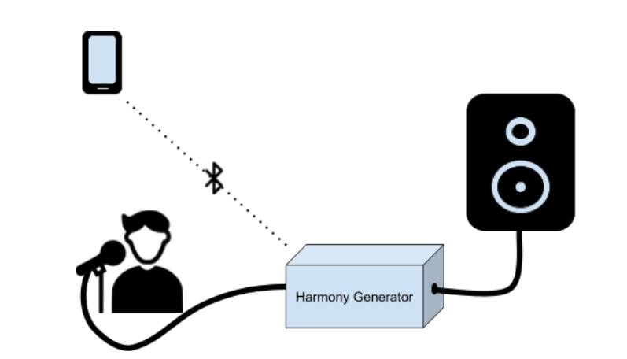
Project Statement
Create a system that allows artists to create multiple harmonies in real time for performances.
Notes:
Jason

Slide 3
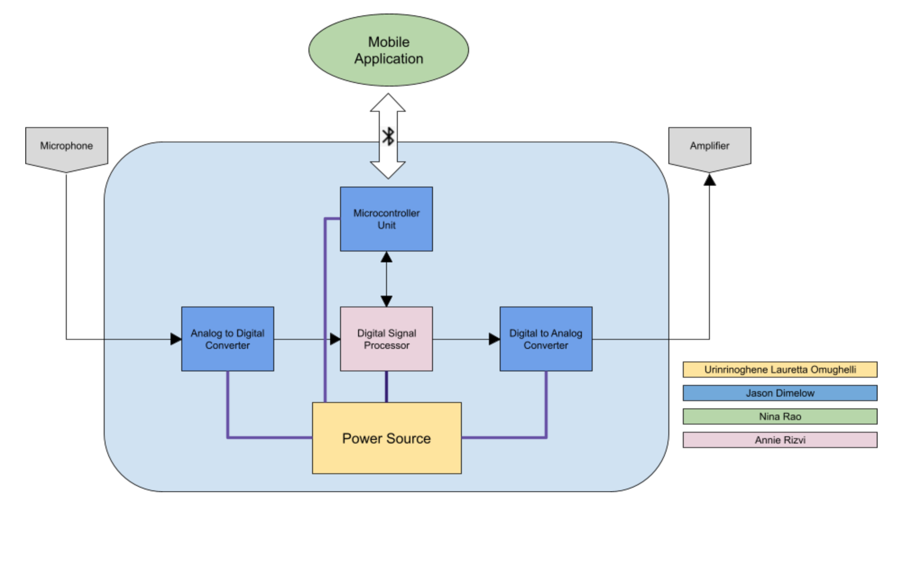
Project Subsystems
Notes:
Nina:

Slide 4
Project Current Timeline
Real-Time Audio Functioning
MCU and Android Application Bluetooth Communication Integrated and Validated
MCU and DSP I2C Communication Integrated and Validated
Power Supply Integrated and Validated

Slide 5
Digital Signal Processor
Accomplishments Since Last Presentation <18 hrs> | Ongoing progress/problems and plans until next presentation
Integrated IQMATHLIB into MSP430 Project Refactored parts of algorithm program into Code Composer Studio | Finish integrating algorithms and validate (non-real time version) Reattempt algorithm with complex DSK Kit for real-time functionality*

Slide 6
Microcontroller Unit
Main Unit Schematic/PCB
Accomplishments Since Last Presentation <3 hrs> | Ongoing progress/problems and plans
Seamless communication between Fuel Gauge, MCU, and Android App
Accomplishments Since Last Presentation <25 Hrs> | Ongoing progress/problems and plans until next presentation
Schematic Completed and Ordered | MSP430 Flash Hardware Solder parts
Notes:
MCU will be relaying data to and fro the dsp/user interface via bluetooth. Telling the DSP what type of harmony the user wants, and then sending the digital to back to the app...

Slide 7
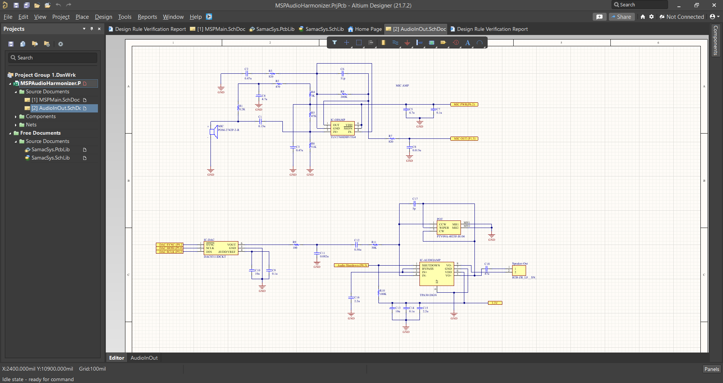
Schematics

Slide 8
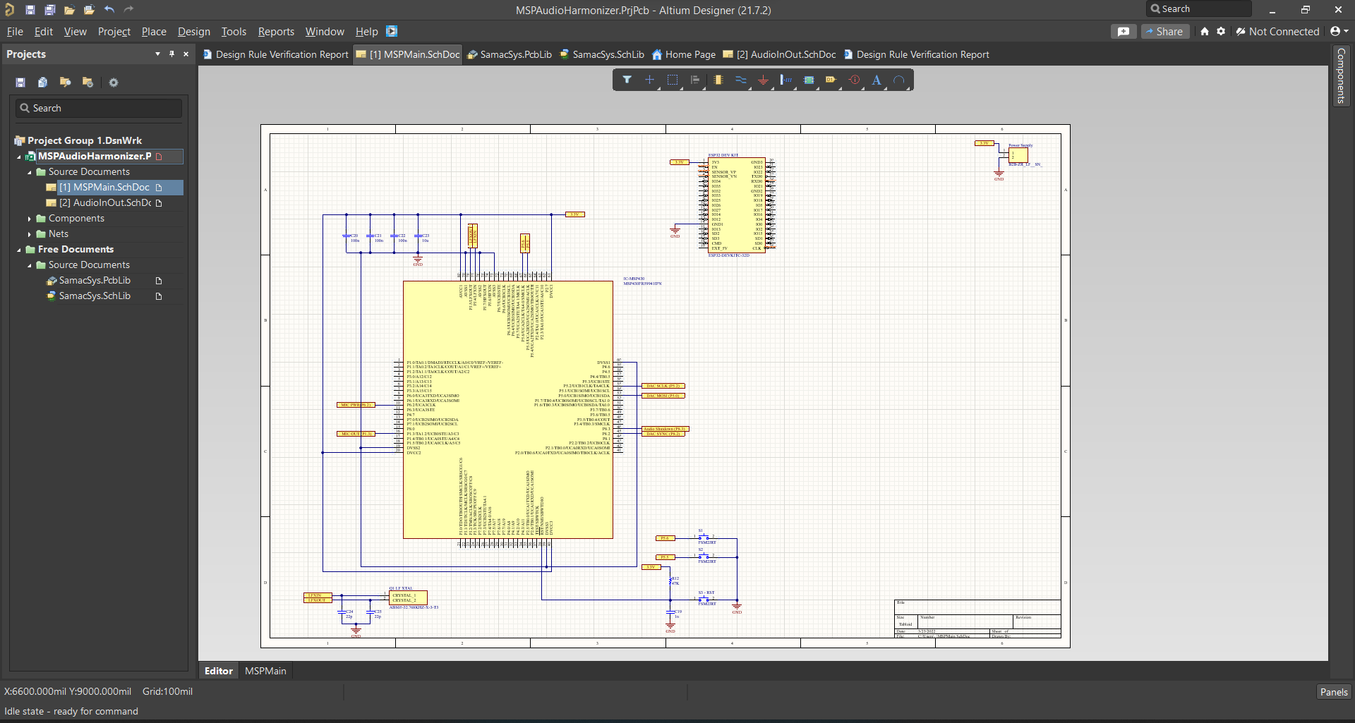

Slide 9
Power Supply Integration with MCU and Android App
Accomplishments Since Our Last Presentation <20 hrs> | Ongoing progress/problems and plans until next presentation
Successfully Integrated power supply with DSP (MSP430) and MCU (ESP32) Successfully Integrated fuel gauge with MCU/App | Validate battery percentage on App Output voltage starts at 2.6 V before reaching 3.3 V- Use linear regulator to fix 2.6 V output

Slide 10
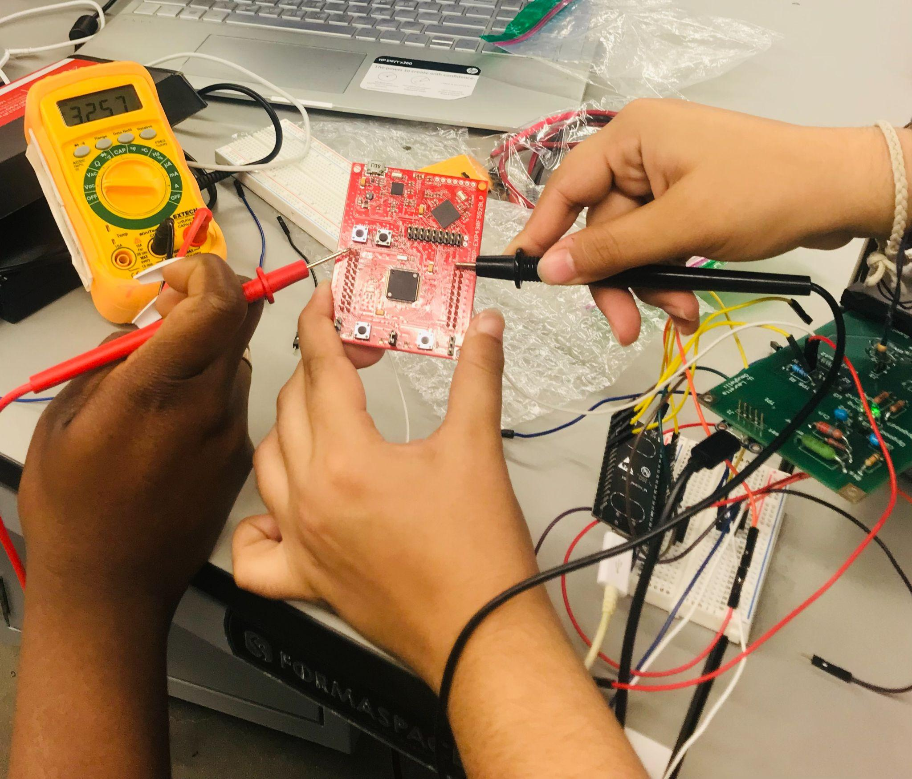
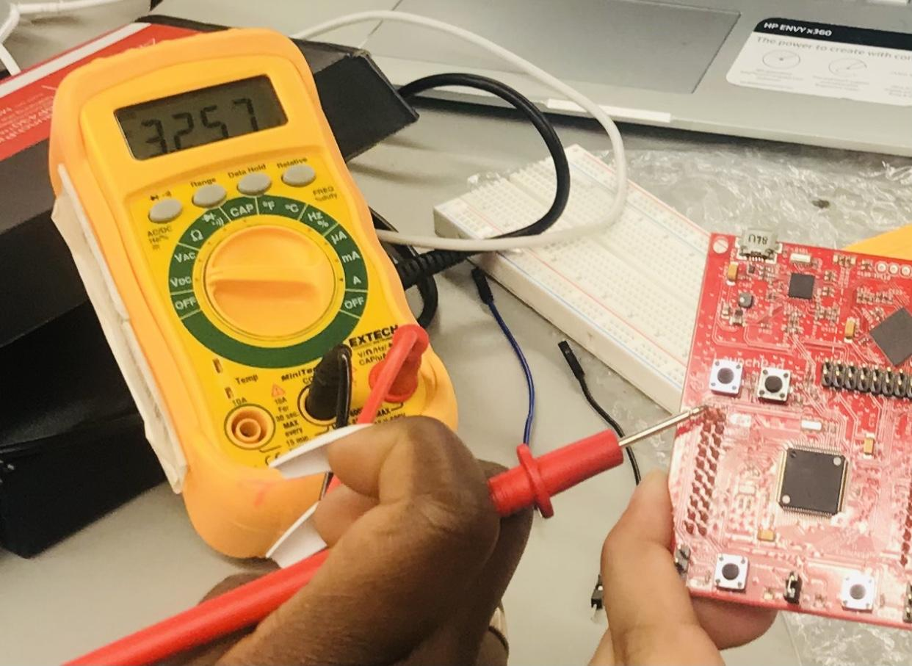
Power Supply Output Voltage Validation with DSP and MCU

Slide 11
Android App
Accomplishments Since Last Presentation <20 hrs> | Ongoing progress/problems and plans until next presentation
Implemented new method for receiving battery level | Android App is complete

Slide 12
Progress

Slide 13
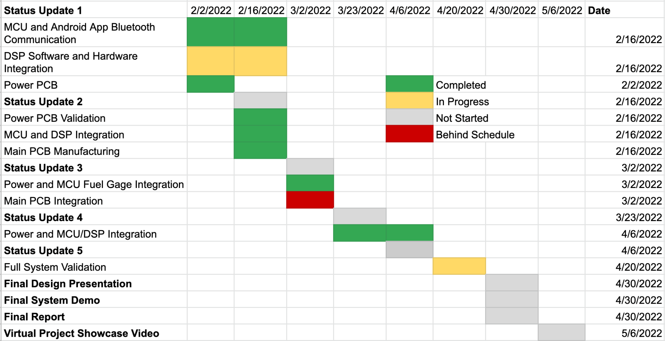
Execution Plan

Slide 14
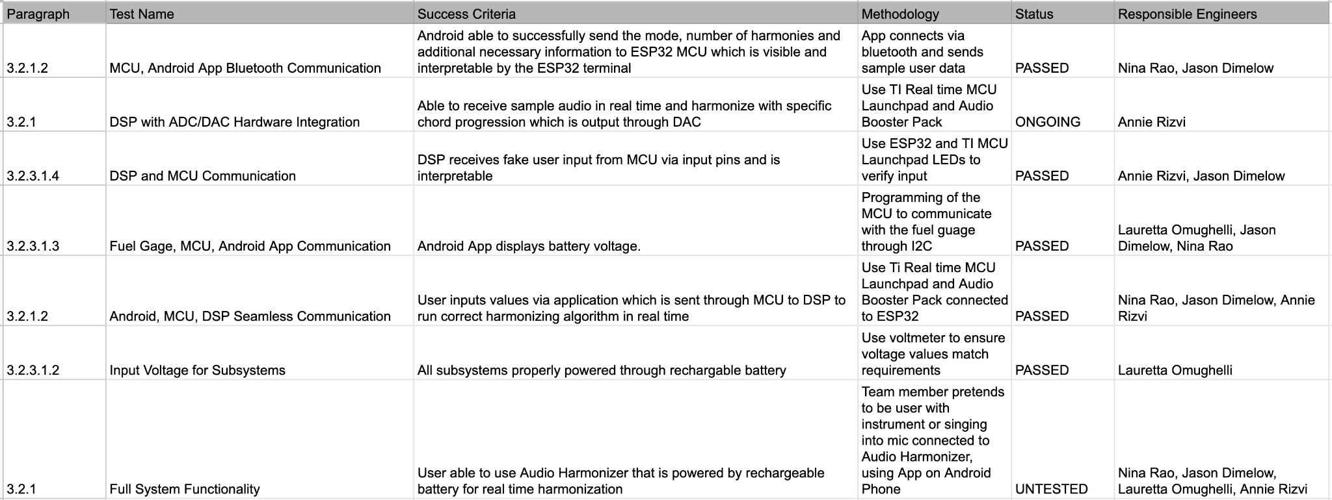
Validation Plan

Slide 15
Questions?

